Slide 1
Facial Landmarks Detection
with Fake-it Dataset

Slide 2
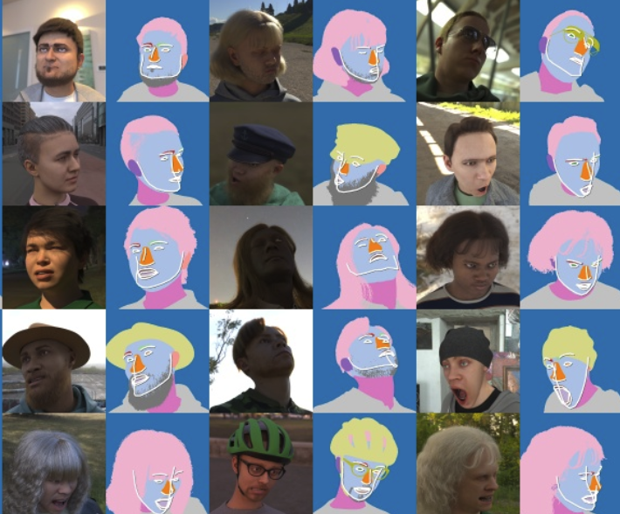
Overview
Design a deep learning neural network model for facial landmarks detection
Train the model on the CG faces
Test the model on the real world faces

Slide 3
Our output
Real world samples of human faces with facial landmarks annotated.

Slide 4
Best Model
Our Model !
MSE Loss | Training loss | Validation Loss | Test Loss
Our Model | 0.00078196 | 0.00007003 | 0.00269198
Xception | 0.00083827 | 0.00002770 | 0.00287737
ResNet-50 | 0.00187827 | 0.00046778 | 0.00385637
MobileNet-v2 | 0.00116653 | 0.00011362 | 0.00336023

Slide 5
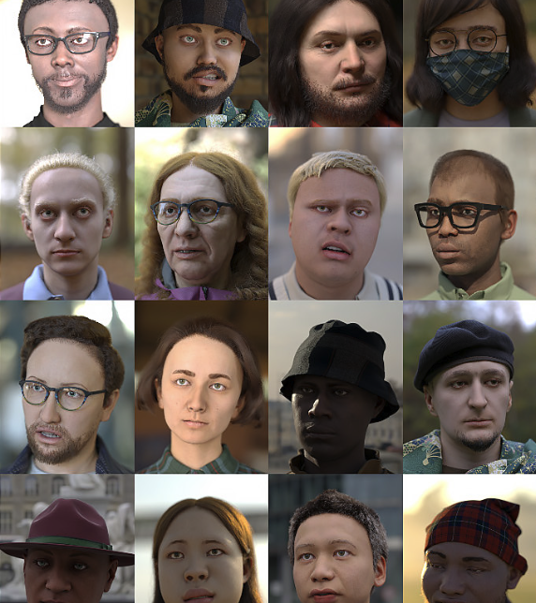
Dataset
Training data:
CG dataset from Microsoft
(with 70 standard facial landmarks)

Slide 6

Dataset
Testing data:
Flickr-Faces-HQ Dataset
Video (30 fps)

Slide 7

Data preprocessing
Box the Face
Original size: 512*512
After resized: 128*128
Implemented through TF.resize and TF.crop

Slide 8
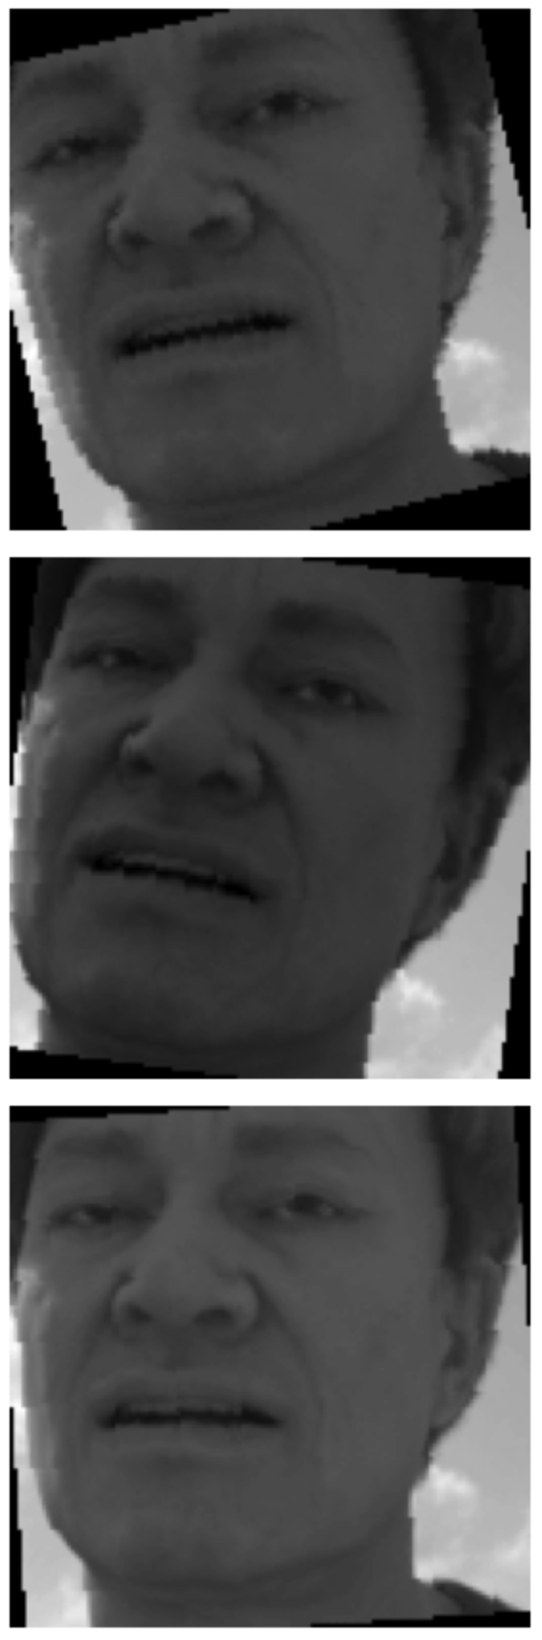
Data augmentation
Random Gamma
Random Contrast
Random Hue
Random Saturation
Random Brightness
Random Rotation

Slide 9
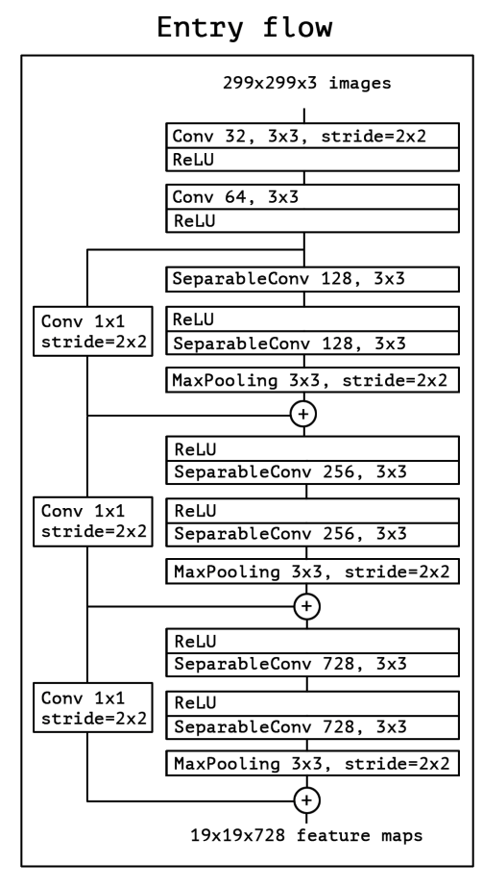
Network architectures
Our Model
Entry Flow
(two residual)
Middle Flow
Exit Flow

Slide 10
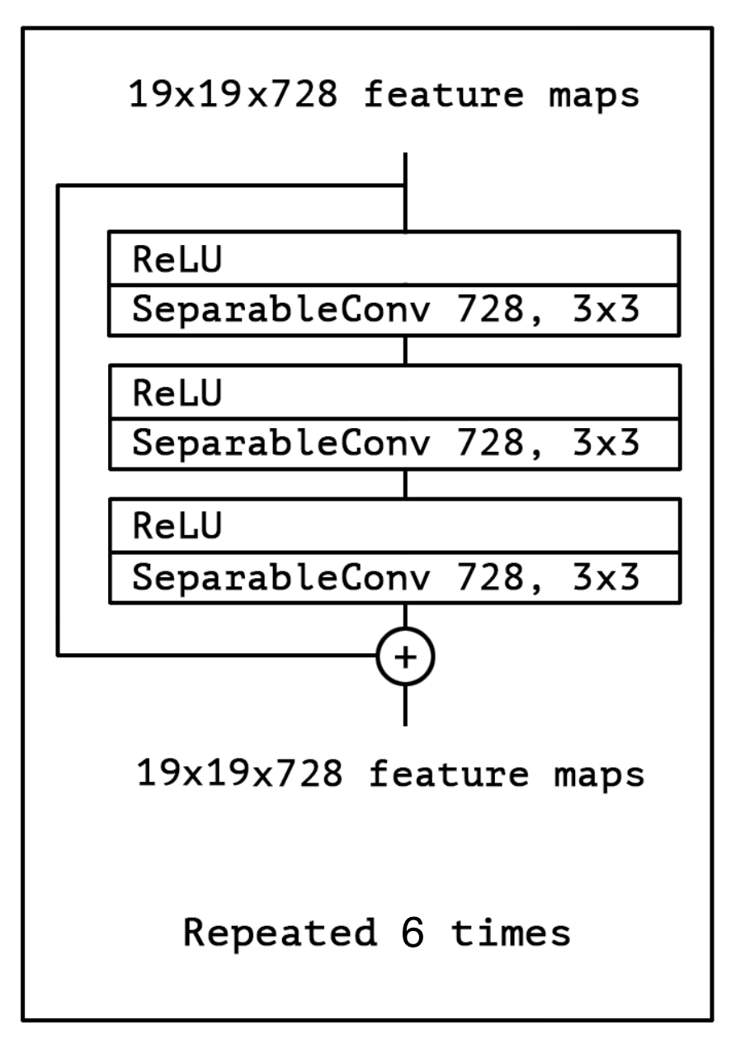
Network architectures
Our Model
Entry Flow
Middle Flow
Exit Flow

Slide 11
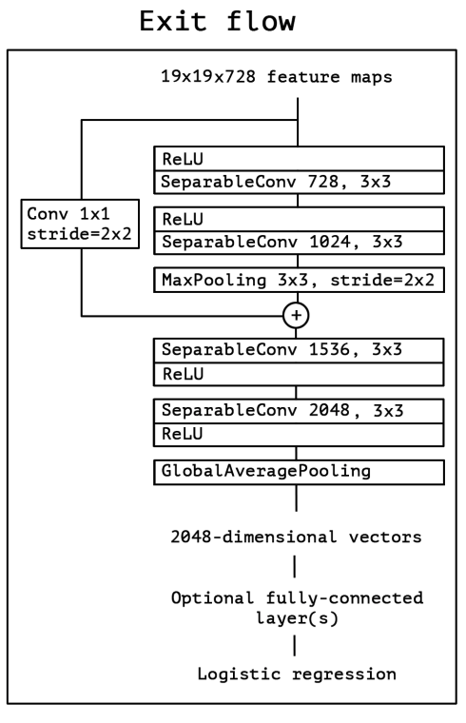
Network architectures
Our Model
Entry Flow
Middle Flow
Exit Flow

Slide 12
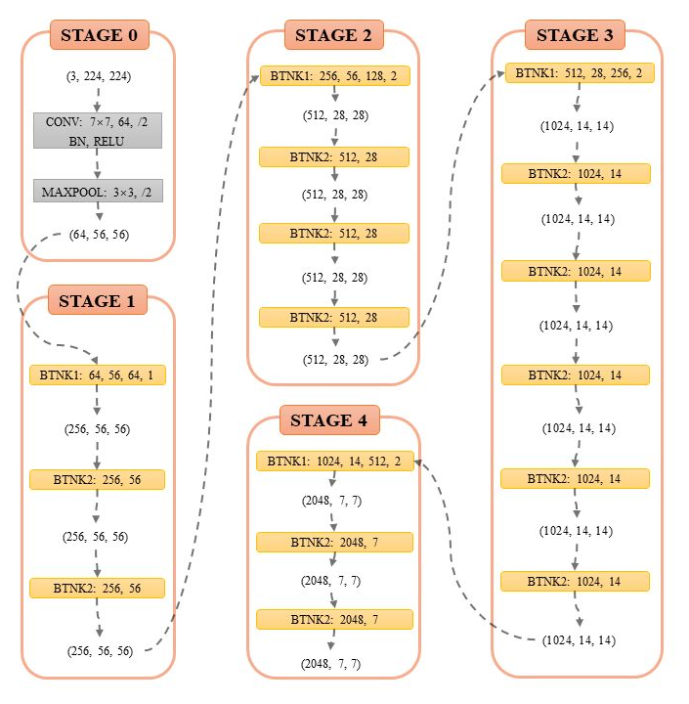
Network architectures
ResNet-50
Stage 0
Stage 1
Stage 2
Stage 3
Stage 4

Slide 13
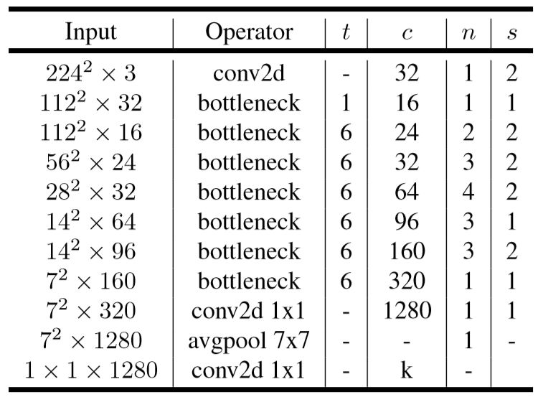
Network architectures
MobileNet_v2
Inverted residual
Bottleneck residual block

Slide 14
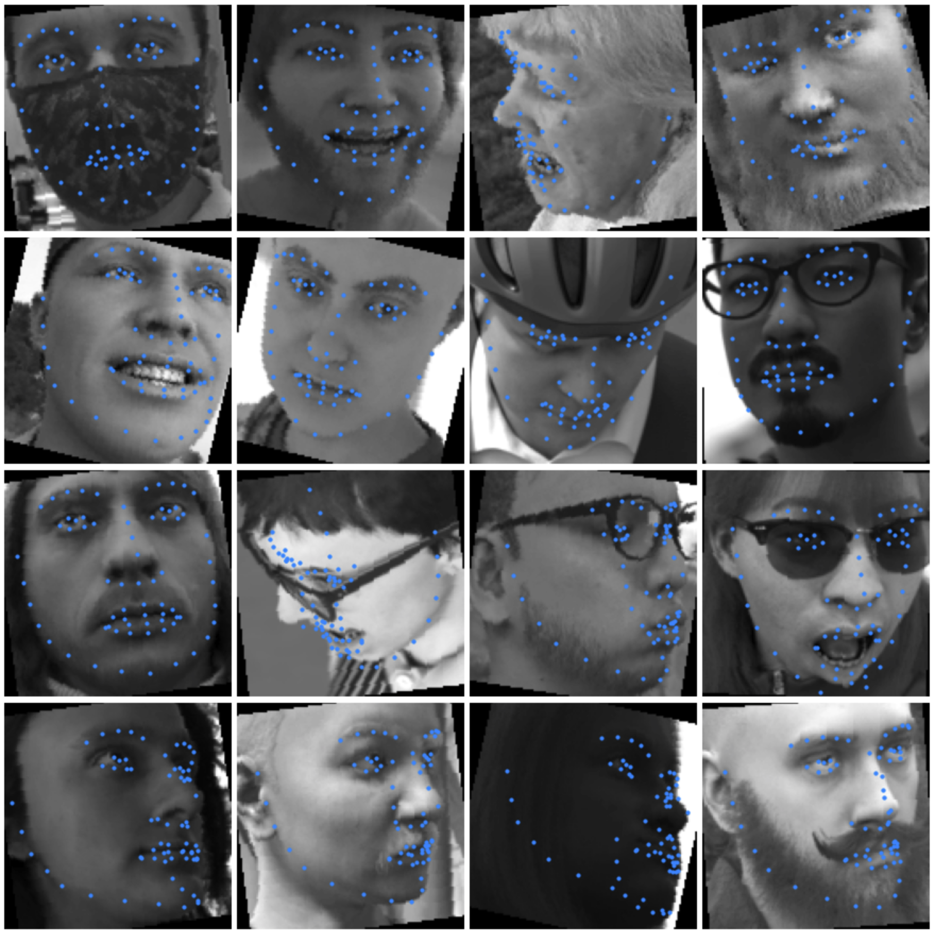
Result
Our model
Validation set prediction

Slide 15
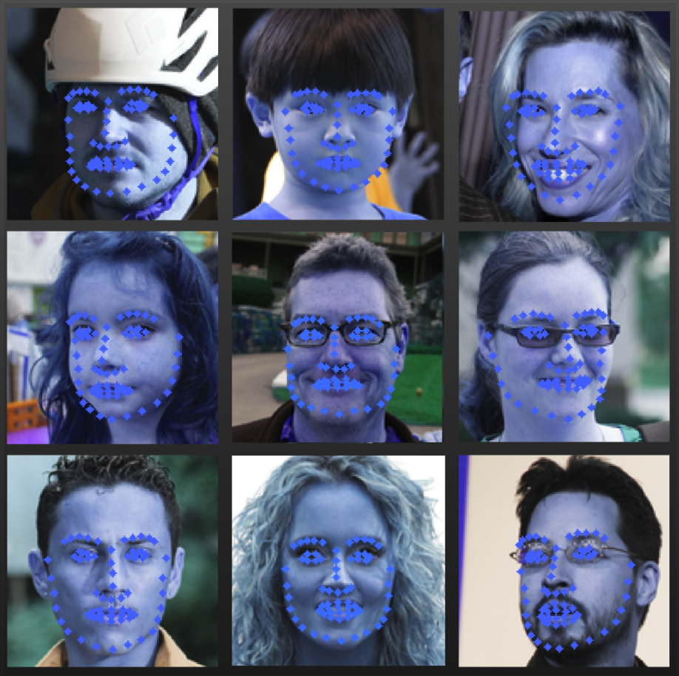
Result
Our model
Test set prediction

Slide 16
Result
Different Versions of Xception Network (5000 images in training set)
MSE Loss | Training loss | Validation Loss | Test Loss
Our Model LeakyReLU & 6 mid | 0.00174931 | 0.00010353 | 0.00334268
Xception | 0.00155704 | 0.00010563 | 0.00339070
Xception with LeakyReLU | 0.00149869 | 0.00018571 | 0.00349785
Xception with 6 mid block | 0.00386720 | 0.00052409 | 0.00654623

Slide 17
Result
Results of Different training set sizes
5000 is a viable size
Validation MSE Loss | Training set 2000 | Training set 5000 | Training set 10000
Our Model | 0.00070798 | 0.00010353 | 0.00003220
Xception | 0.00091584 | 0.00010563 | 0.00003259
ResNet50 | 0.00120577 | 0.00018337 | 0.00007236
MobileNet-v2 | 0.00045519 | 0.00023415 | 0.00006439

Slide 18
Result
Results of our model, Xception network, ResNet-50, and MobileNet_v2
after Hyperparameter optimization
MSE Loss | Training loss | Validation Loss | Test Loss
Our Model | 0.00078196 | 0.00007003 | 0.00269198
Xception | 0.00083827 | 0.00002770 | 0.00287737
ResNet50 | 0.00187827 | 0.00046778 | 0.00385637
MobileNet-v2 | 0.00116653 | 0.00011362 | 0.00336023

Slide 19
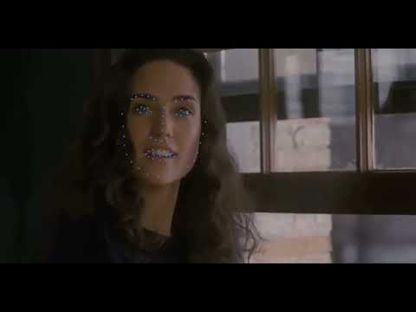

Slide 20
Reference
Erroll Wood, Tadas Baltrusaitis, Charlie Hewitt, Sebastian Dziadzio, Thomas J. Cashman, Jamie Shotton.: Fake it till you make it: face analysis in the wild using synthetic data alone. International Conference on Computer Vision 2021. https://openaccess.thecvf.com/content/ICCV2021/html/Wood_Fake_It_Till_You_Make_It_Face_Analysis_in_the_ICCV_2021_paper.html
ChihFan Hsu, ChiaChing Lin, TingYang Hung, ChinLaung Lei, KuanTa Chen: Annotated Facial Landmarks in the Wild: A large-scale, real-world database for facial landmark localization. arXiv:2005.08649. https://arxiv.org/abs/2005.08649

Slide 21
Thank you!

